Slide 1
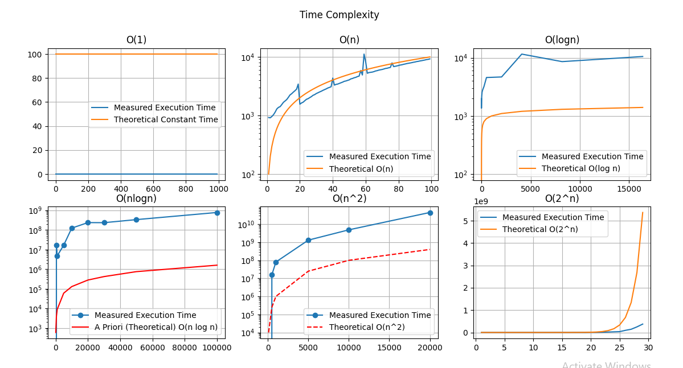
Algorithm
Comparison
By:
Name: Alok Pandey
Course: B.Voc Software Development
University Roll No.: 22020107030
GitHub Link:
https://github.com/thealokpandey/Algo-comparision

Slide 2
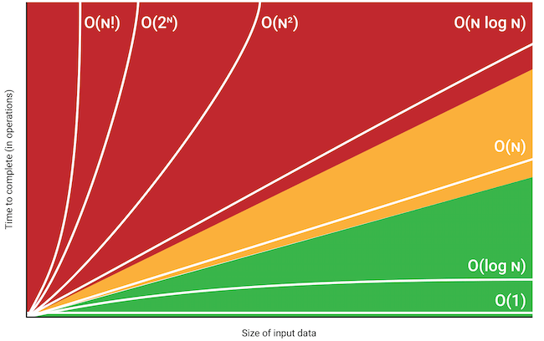
Objective:
This project will showcase the real execution time vs the theoretical time complexity of different algorithm.
Answer to the question “why do we choose any particular algorithm for a task?”.

Slide 3
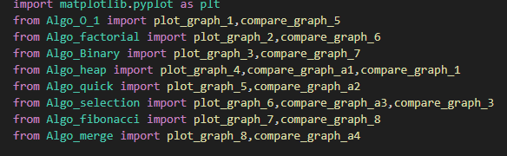
How does the system works?
There are in total 9 files, out of which the main.py is the head file which helps in calling all the rest file as per the choice of user.
The rest 8 files contains 8 algorithms that work on different set of dataset to get an approximate graph on the real execution time, which in later phase is compared to the graph of theoretical time complexity found by the formula.
On top of that the 8 files are capable on working on their own too.

Slide 4
Content:
Comparison:
Comparison between Sorting Algorithms.
Comparison between all time complexities.
Algorithms:
O(1) Linear Search
O(n) Factorial
O(logn) Binary Search
O(nlogn) Heap Sort
O(nlogn) Quick Sort
O(n^2) Selection Sort
O(2^n) Fibonacci
O(nlogn) Merge Sort
Points to be noted:
User can choose from various options.
Easy understanding of project.

Slide 5
How does the project stand out?
User-Friendly Interface
Variety of Algorithms to compare between
Graphical representation

Slide 6
Technologies and Idea behind the project:
Python:
Matplotlib
Subplot
Time
time.ns
numpy
Random
The code is written in python for easy understanding and updating.
Different libraries are used to get the desired output.
Idea:
To find the accuracy of the time complexity formula and understand the trend.
To choose between several algorithms based on speed.

Slide 7
Future Plans:
Looking forward to increase the number of algorithms and show minor differences too.
Also plan on making a website which will help user easy access to the stuff.
Still working on some features like different types of graph and dynamic features.
The range of dataset can be increased to have a better outcome.
Call for a diffencing table and point out the best possible spot for and particular dataset.

